Slide 1
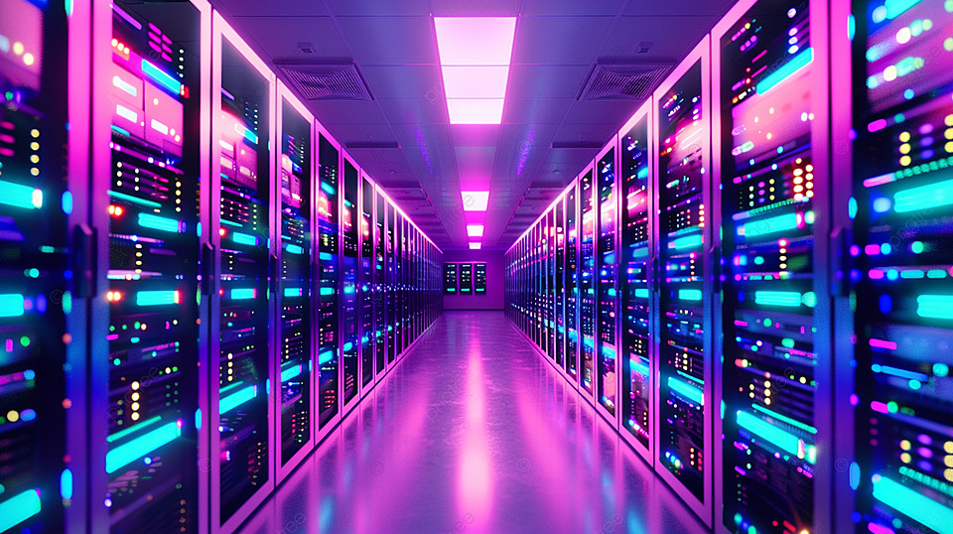

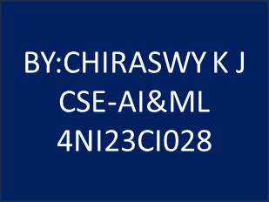

Slide 2
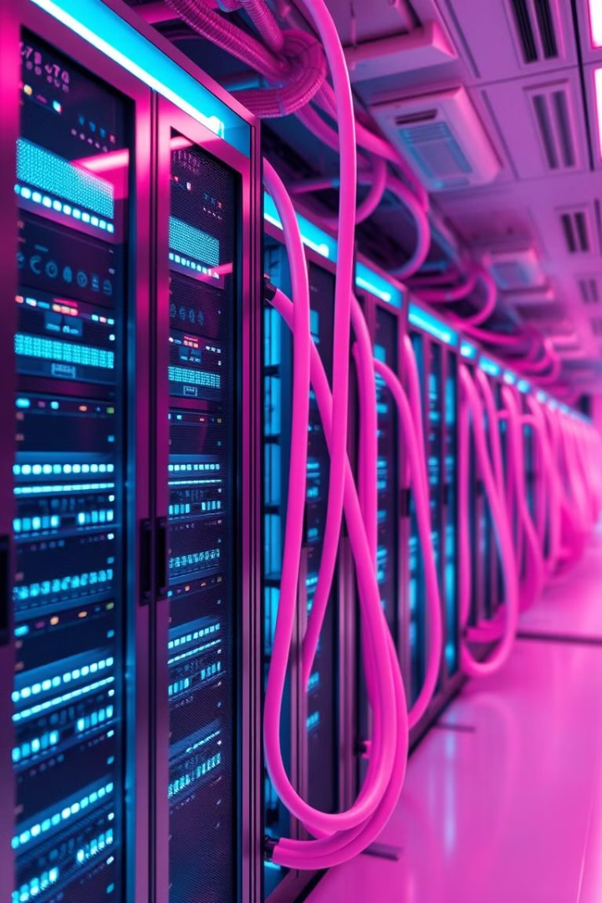
SecureNet: AI-Driven Security for the IoT
At Dell Technologies, we're committed to empowering individuals and organizations to lead in a digital-first world. We understand the growing challenges of securing interconnected devices, especially in the rapidly expanding Internet of Things (IoT) landscape. SecureNet is our solution, offering hands-on training for professionals seeking to deepen their expertise in AI-driven threat detection and intrusion prevention within IoT networks.

Slide 3
The Challenge: Securing the Expanding IoT
Growing Interconnectivity
Limitations of Traditional Security
As more devices become interconnected through the Internet of Things (IoT), securing these devices from cyber threats becomes increasingly challenging.
Traditional security methods often fail to detect real-time attacks, leading to breaches.

Slide 4
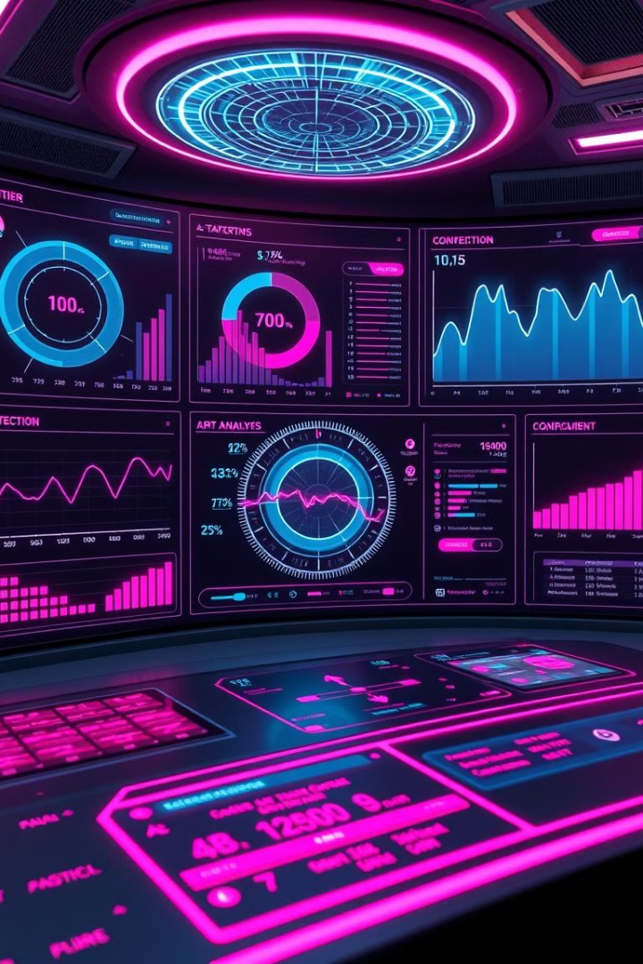


The SecureNet Solution: AI & ML for Real-Time Threat Detection
Real-Time Threat Detection
Proactive Prevention
Machine learning models identify and block malicious activities before they can cause harm.
AI algorithms analyze network traffic and identify potential threats in real-time.

Slide 5


SecureNet: The Future of IoT Security
1
Enhanced Resilience
2
Future-Proofing
SecureNet helps organizations build more secure, resilient networks, capable of adapting to evolving threats.
SecureNet equips professionals with the skills they need to safeguard tomorrow's connected world.

